Slide 1
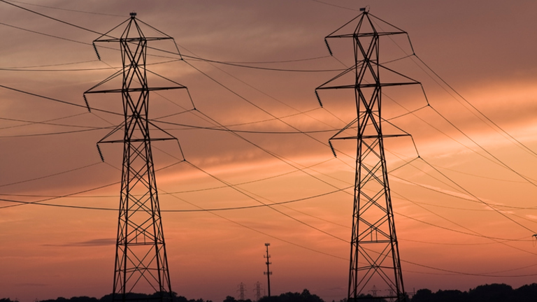
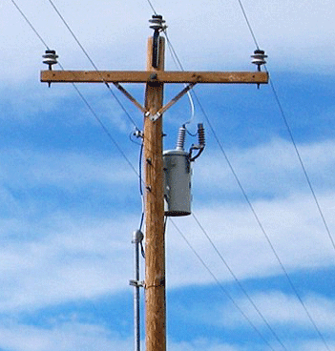
3 Phase Power Supply System

Slide 2
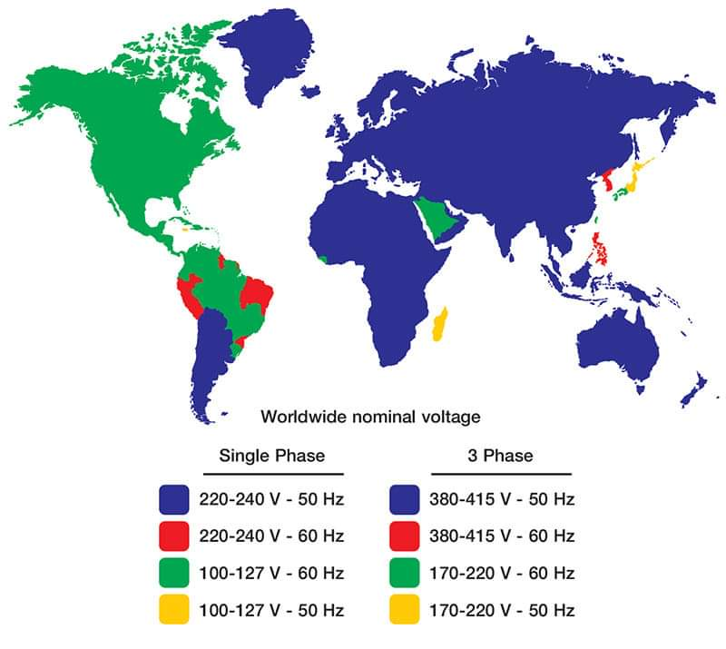

Slide 3

3 Phase Waveform
Single Phase Waveform

Slide 4
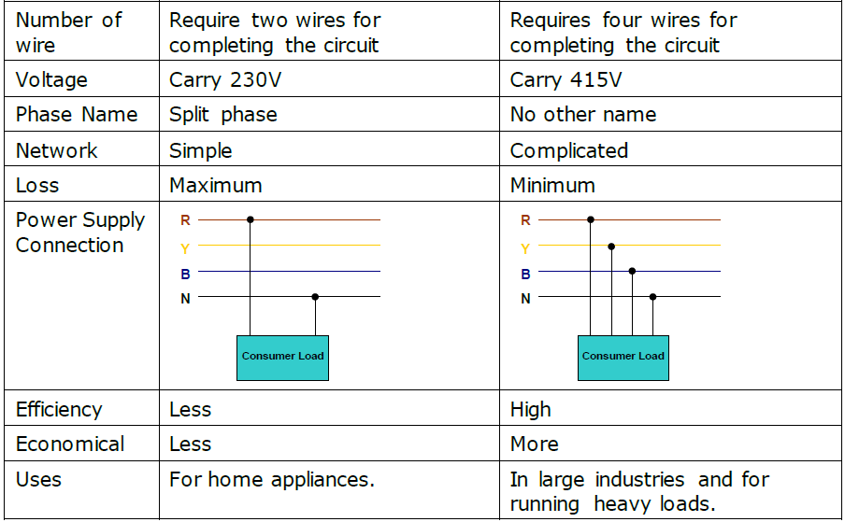
Comparison of Single & 3 Phase Power Supply

Slide 5
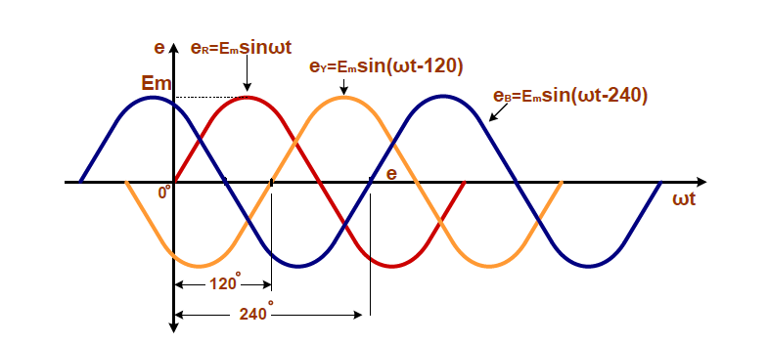
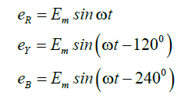

Slide 6
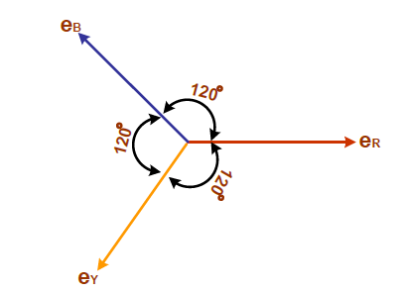
Vector Representation of 3Phase Voltage

Slide 7
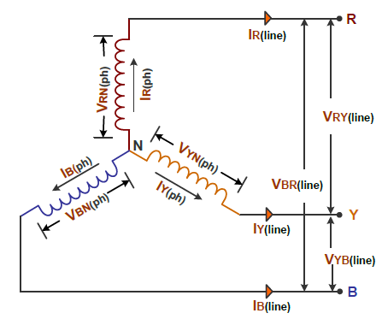
Star Connection

Slide 8
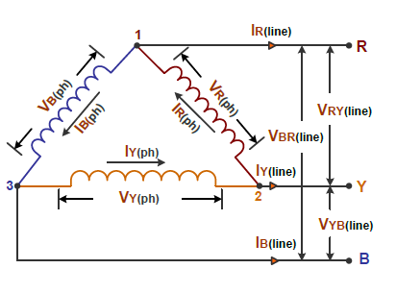
Delta Connection

Slide 9
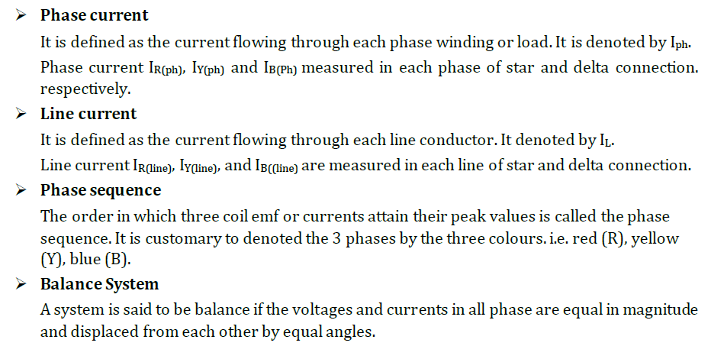
Basic Definition of 3 Phase System

Slide 10

Basic Definition of 3 Phase System

Slide 11
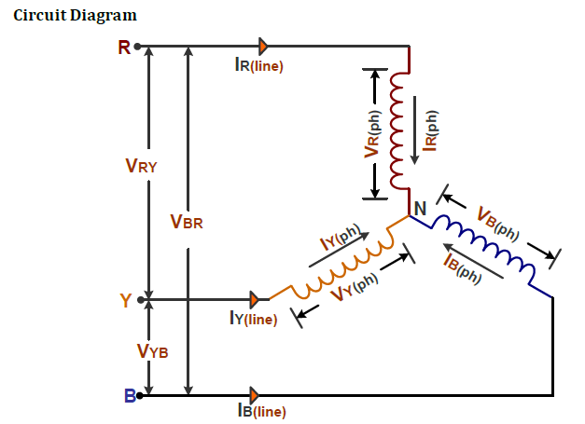
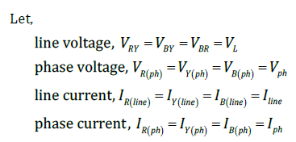

Slide 12


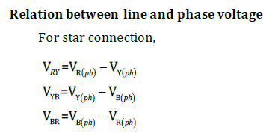

Slide 13
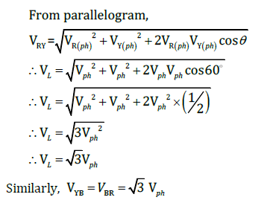
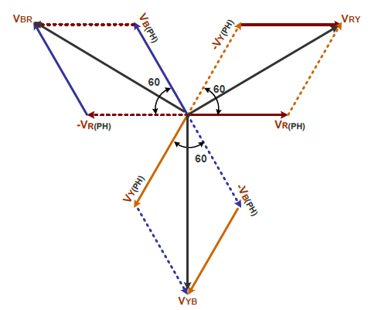

Slide 14
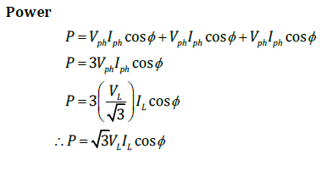

Slide 15
2nd Derivation

Slide 16
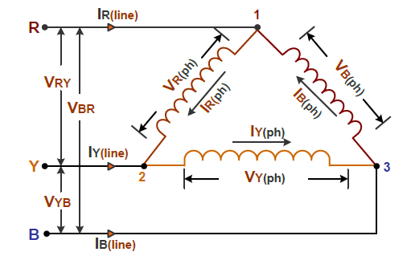
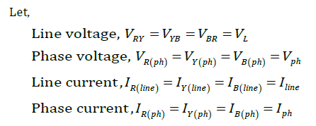

Slide 17
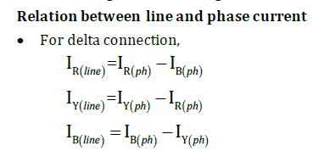
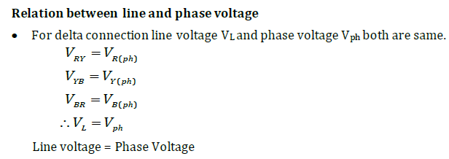

Slide 18
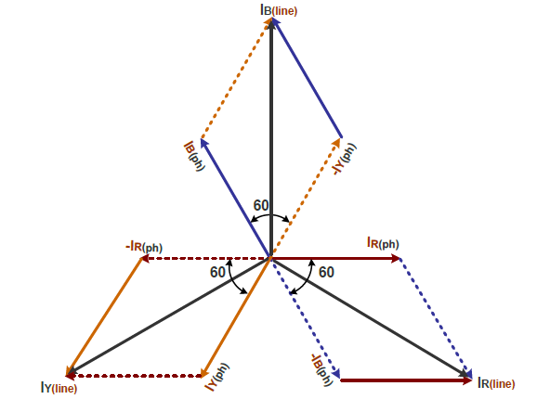
Phasor Diagram

Slide 19
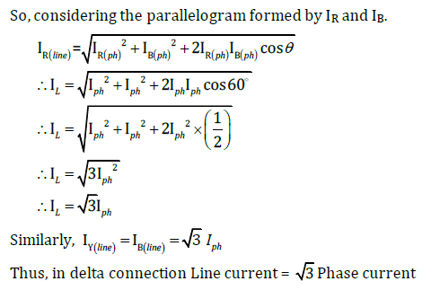

Slide 20
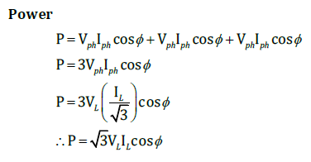

Slide 21
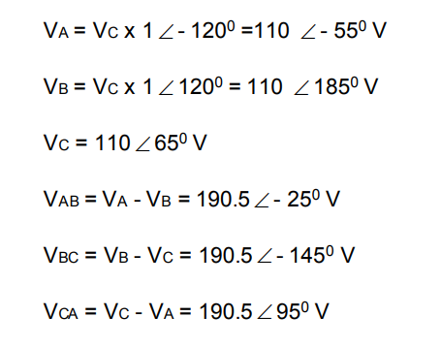
Problem No.1
In a three-phase balanced supply, voltage VC =110 ∟65º .Taking the phase sequence as ABC, find the phase and line voltages.

Slide 22
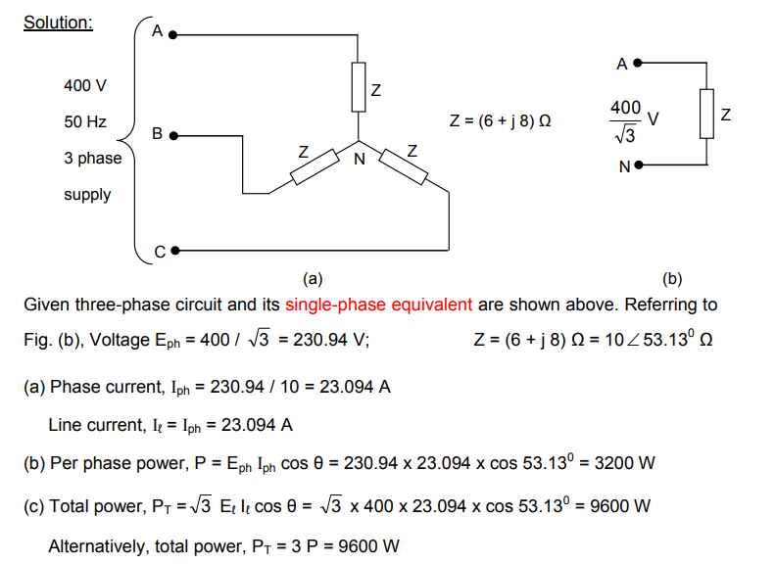
A balanced three-phase load connected in star consists of (6 + j 8) Ω impedance in each phase. It is connected to a three-phase supply of 400 V, 50 Hz. Find (a) magnitude of phase current and line current (b) per phase power and (c) total power.
Problem No.2

Slide 23
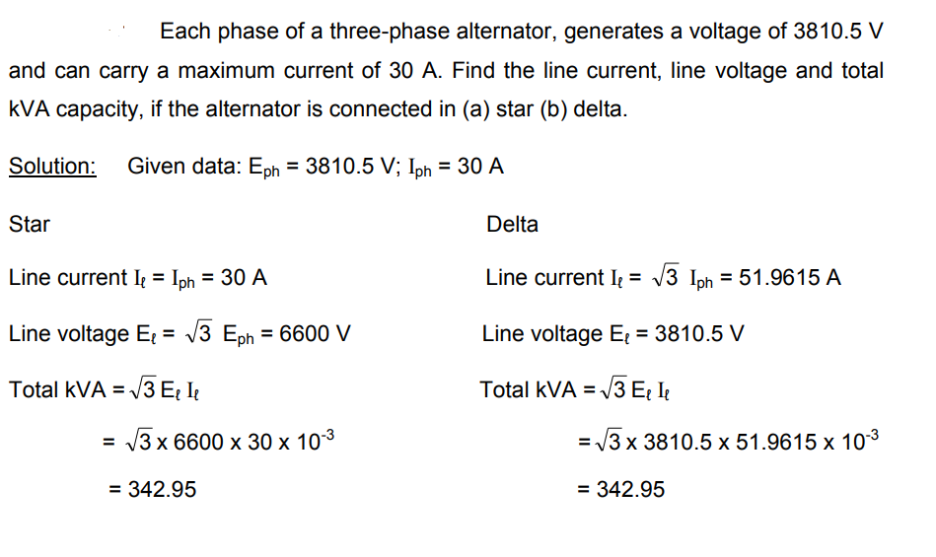
Problem No.3

